Slide 1
NAAN MUDHALVAN DATASCIENCE FUDAMANETAL PROJECT
PROJECT TITLE:
RED wINE QUALITY
PRESENTED BY:
S.MUKESH KANNAN
SACS M.A.V.M.M. ENGINEERING COLLEGE
III YR MECH DEPT

Slide 2
Project statement:
Project Statement: "To assess and enhance red wine quality through comprehensive analysis of key factors including grape variety, fermentation techniques, aging processes, and environmental influences. The project aims to utilize data-driven methodologies to identify optimal conditions and techniques for producing high-quality red wine, thereby providing valuable insights for winemakers and enhancing consumer satisfaction

Slide 3
Project solution:
Solution Overview: The solution involves a multi-faceted approach to improving red wine quality, incorporating both traditional winemaking techniques and modern data-driven methodologies. Key components include:

Slide 4
System approach
Building the proposed solution would involve a combination of data processing, pyth0n programming and visualization skills.
System requirements:
Hardware :
A computer with sufficient processing power, preferably with multiple cores or a GPU for faster training of machine learning models.
Adequate RAM to handle the size of the dataset and computational requirements.
Software:
- An operating system compatible with the required python libraries (e.g., windows,linux,macOS).

Slide 5
System approach – CONT.
Library Requirements:
Data processing and analysis:
Pandas : For data manipulation and analysis.
Numpy : For numerical operations on data.
Data visualization:
Matplotlib and seaborn: For creating visualizations to understand data patterns.
Plotly or Bokeh: Interactive visualization libraries for more complex visualizations.

Slide 6
ALGORITHM & DEPLOYMENT
Algorithm selection
Data exploration :
Explore the movie rating structure, features and variables.
Identify potential patterns, correlations and outliners.
Problem formulation:
Define the problem: Predict optimal booking times, likelihood of special requests based on historical data.
Algorithm selection:
Regression tasks(e.g., predicting daily rates)
Consider linear regression, decision tree, or ensemble methods
classification tasks(e.g., predicting special requests);
Consider logistic regressive, decision trees or random forests.

Slide 7
ALGORITHM & DEPLOYMENT
Data input:
Data collection:
Gather historical data including booking dates ,special requests,and relevant details.
Data cleaning:
Handle missing values, outliners, and any inconsistencies in the dataset.
Convert categorical variables into numerical representation through encoding techniques.
Feature Engineering:
Create new features or modify existing ones based on domain knowledge.
Extract meaningful information from date variables, such as day-of-week or month.

Slide 8
ALGORITHM & DEPLOYMENT
Training process:
Data splitting:
Divide the dataset into training and testing sets to evaluate the model’s performance.
Feature scaling:
Standardize or normalize numerical features to ensure they have consistent scale.
Modeling training:
Use the selected algorithm to train the model on the all sites scores dataset.
Adjust hyperparameters to optimize model performance.
Model evaluation:
Evaluate the model on the dataset using appropriate metrics(e.g., Mean Squared Error for regression,accuracy,precision, recall for classification).
Fine-tune the model if necessary.

Slide 9
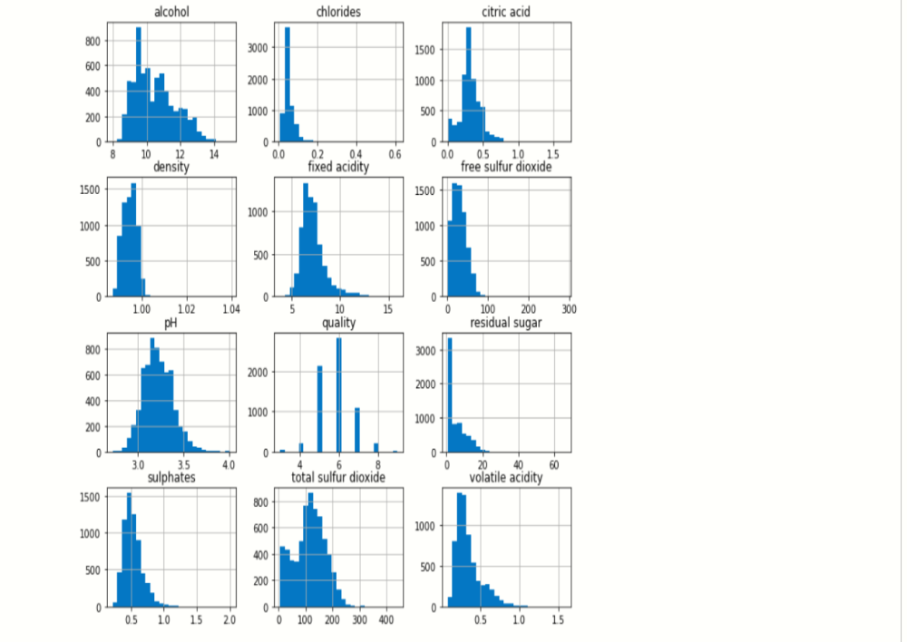
Result:

Slide 10
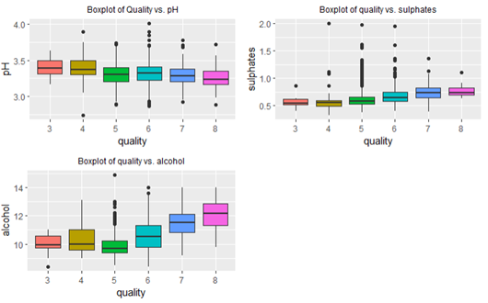
Cont...

Slide 11
Conclusion:
In conclusion, the quest for enhancing red wine quality involves a holistic approach that combines traditional winemaking techniques with modern advancements in data analysis, technology, and consumer feedback. By leveraging historical data, sensor technology, rigorous quality control measures, experimental trials, expert collaboration, and consumer insights, winemakers can continuously refine and innovate their processes to produce high-quality red wines that satisfy the evolving preferences of consumers.

Slide 12
THANK YOU

